Slide 1



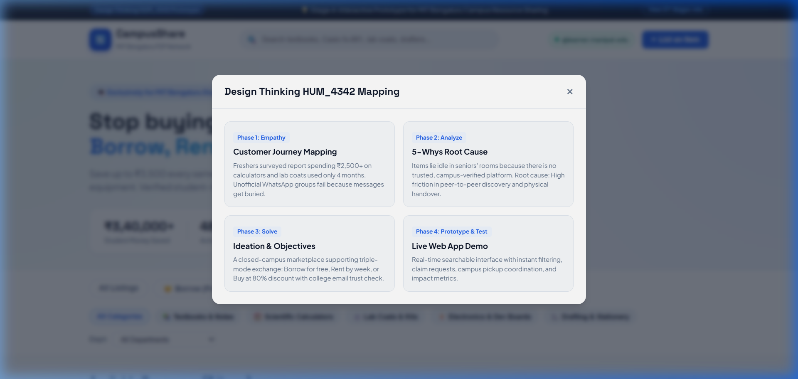
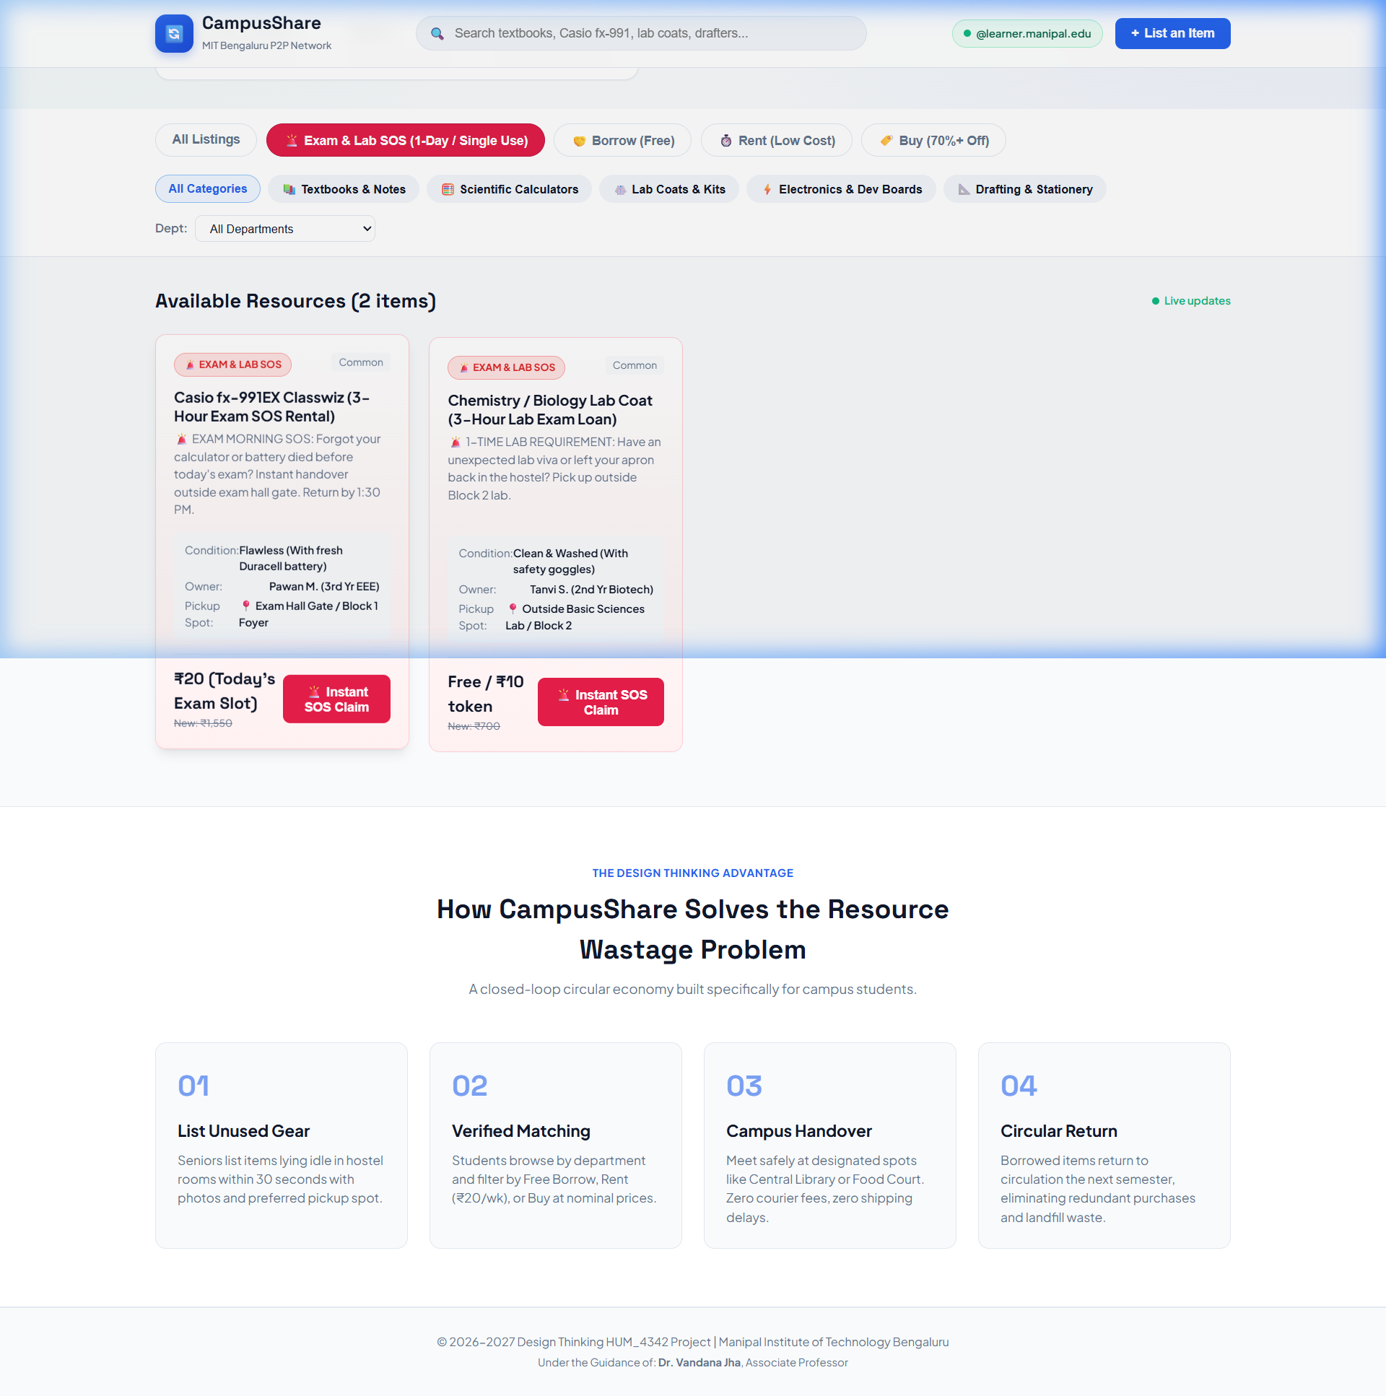
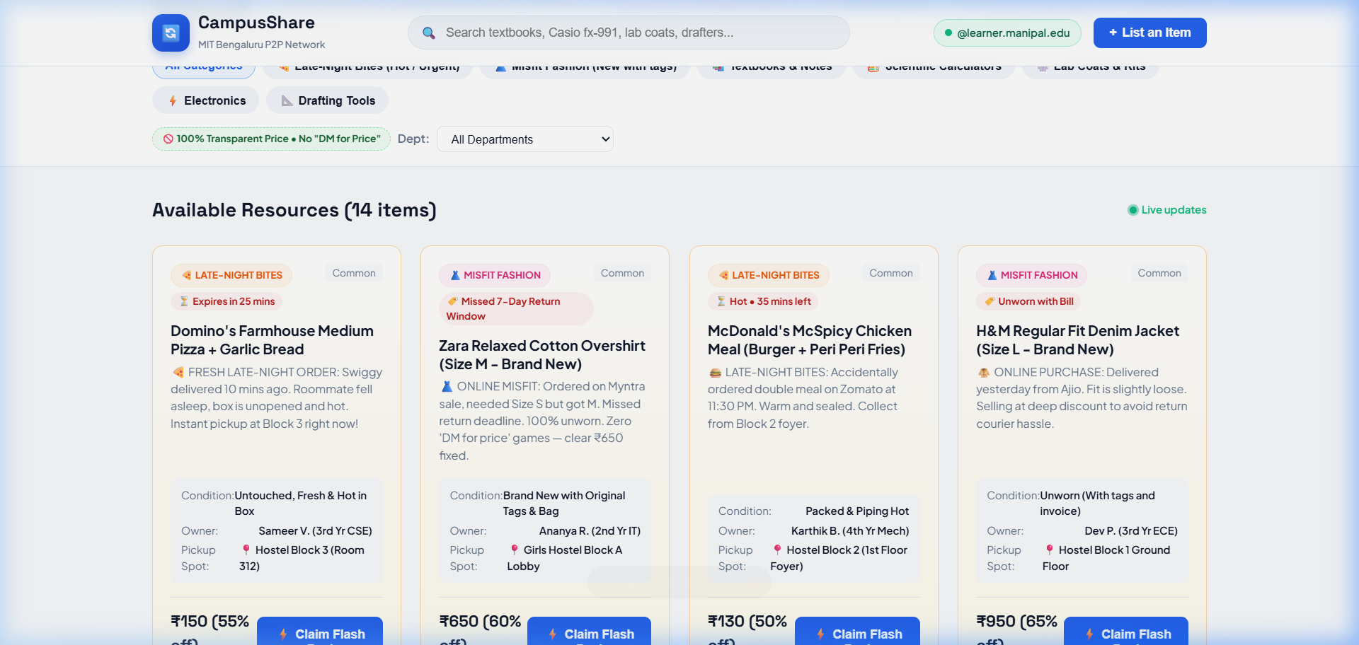
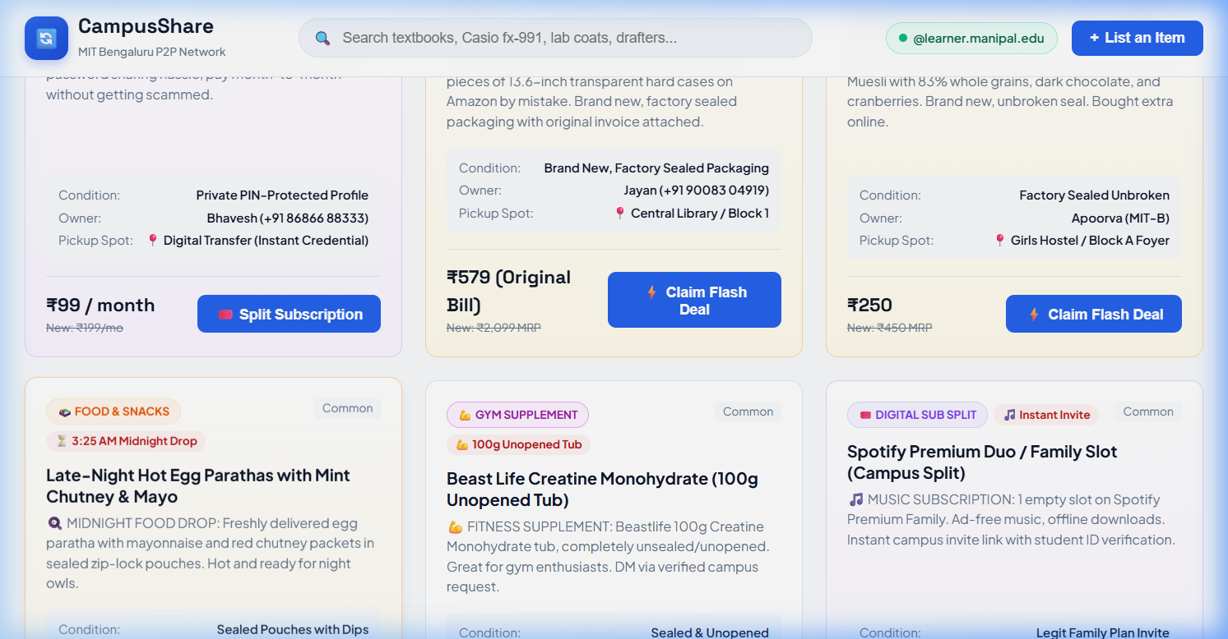
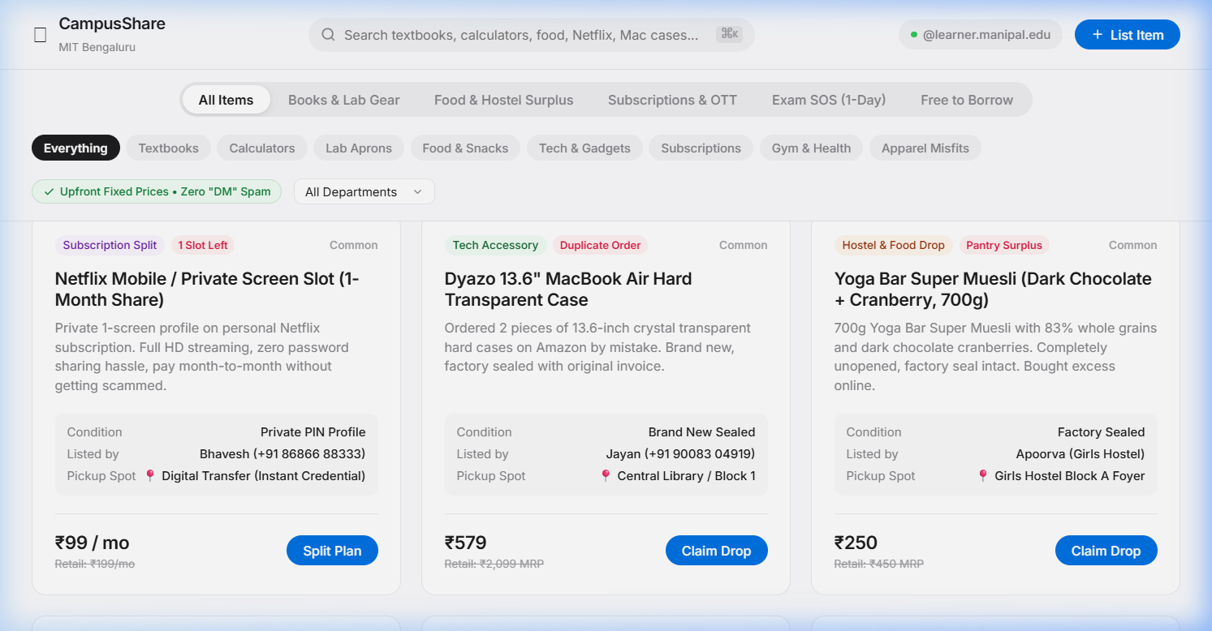
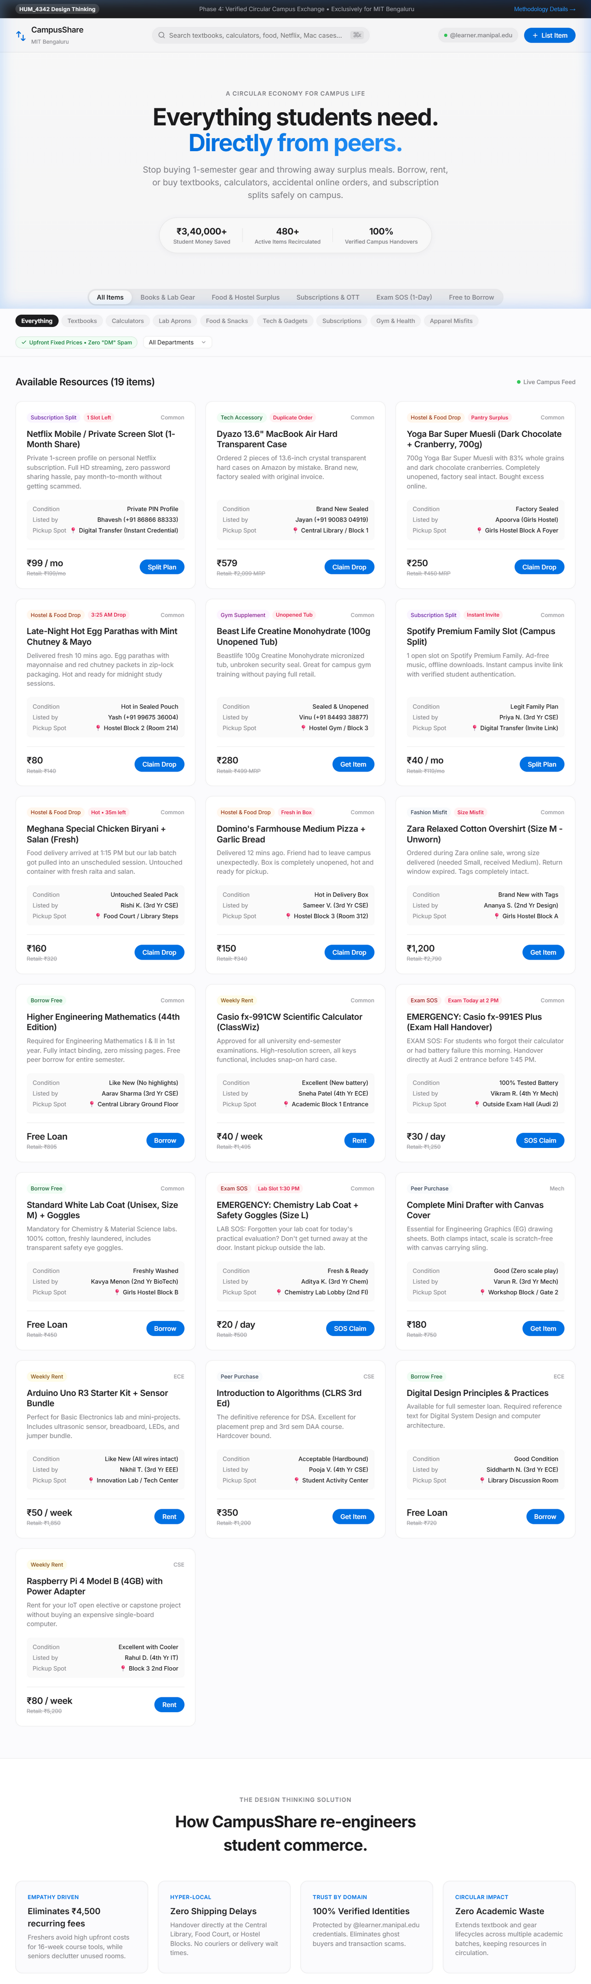
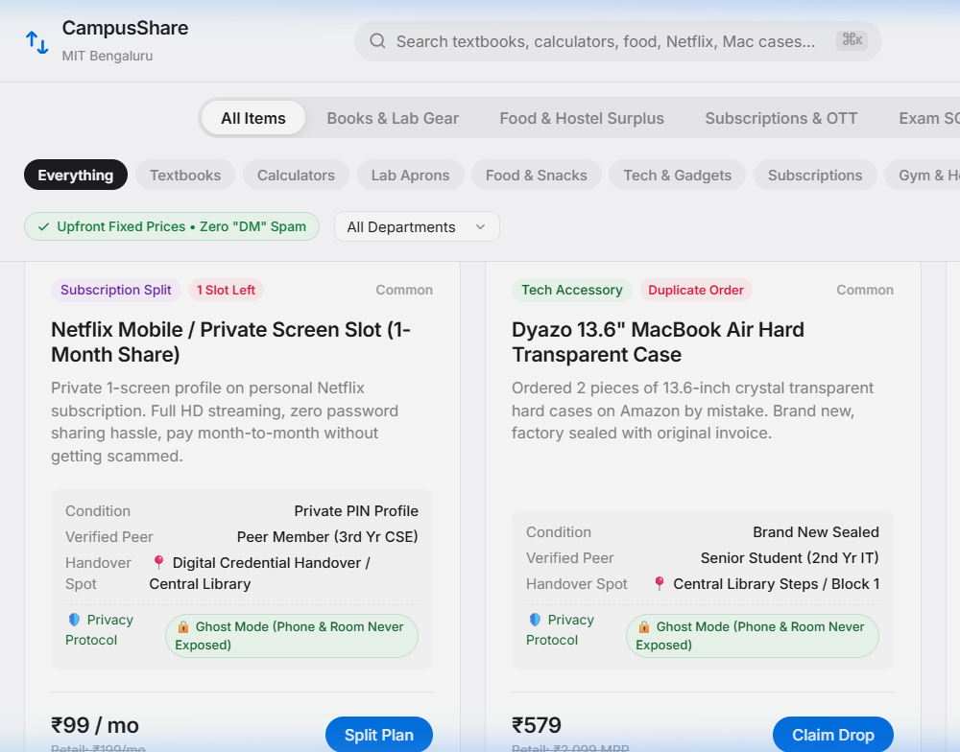
DESIGN THINKING (HUM_4342)
CampusShare: Peer-to-Peer Campus Resource & Book Exchange
MIT
Bengaluru
Team Members: [Team Member 1 | Team Member 2] • Reg Nos: [2309xxxxx | 2309xxxxx]
Mentor: Dr. Vandana Jha, Associate Professor • Manipal Institute of Technology Bengaluru, MAHE
OBJECTIVE
Phase 3: Solve
PHASE 1: EMPATHY & OBJECTIVE
• Project Objective: Create a zero-friction, verified circular exchange platform allowing engineering students to Borrow, Rent, or Buy single-semester academic gear (textbooks, Casio fx-991 calculators, lab coats, drafters) from seniors at near-zero cost.
• User Pain Point (Survey of 25 MIT-B Students):
• - 88% of freshers spend ₹2,500–₹4,500 every semester on specialized gear used for only 16 weeks.
• - 92% of seniors have 3+ textbooks & tools sitting idle in hostel cupboards with no easy way to transfer them.
• - Existing WhatsApp groups fail: notices get buried under hundreds of messages within 15 minutes.
• Customer Journey Mapping Highlights:
• - Touchpoints: Syllabus release -> WhatsApp panic -> Senior negotiation -> Handover friction -> Disposal.
• - Emotional Dip: High anxiety during 1st month due to unexpected equipment expenses.
• Problem Statement: Freshers face recurring financial burdens while seniors hoard unused academic supplies, caused by the absence of a structured, campus-verified peer-to-peer exchange.
PHASE 1: EMPATHY & OBJECTIVE
• Project Objective: Create a zero-friction, verified circular exchange platform allowing engineering students to Borrow, Rent, or Buy single-semester academic gear (textbooks, Casio fx-991 calculators, lab coats, drafters) from seniors at near-zero cost.
• User Pain Point (Survey of 25 MIT-B Students):
• - 88% of freshers spend ₹2,500–₹4,500 every semester on specialized gear used for only 16 weeks.
• - 92% of seniors have 3+ textbooks & tools sitting idle in hostel cupboards with no easy way to transfer them.
• - Existing WhatsApp groups fail: notices get buried under hundreds of messages within 15 minutes.
• Customer Journey Mapping Highlights:
• - Touchpoints: Syllabus release -> WhatsApp panic -> Senior negotiation -> Handover friction -> Disposal.
• - Emotional Dip: High anxiety during 1st month due to unexpected equipment expenses.
• Problem Statement: Freshers face recurring financial burdens while seniors hoard unused academic supplies, caused by the absence of a structured, campus-verified peer-to-peer exchange.
PHASE 1: EMPATHY & OBJECTIVE
• Project Objective: Create a zero-friction, verified circular exchange platform allowing engineering students to Borrow, Rent, or Buy single-semester academic gear (textbooks, Casio fx-991 calculators, lab coats, drafters) from seniors at near-zero cost.
• User Pain Point (Survey of 25 MIT-B Students):
• - 88% of freshers spend ₹2,500–₹4,500 every semester on specialized gear used for only 16 weeks.
• - 92% of seniors have 3+ textbooks & tools sitting idle in hostel cupboards with no easy way to transfer them.
• - Existing WhatsApp groups fail: notices get buried under hundreds of messages within 15 minutes.
• Customer Journey Mapping Highlights:
• - Touchpoints: Syllabus release -> WhatsApp panic -> Senior negotiation -> Handover friction -> Disposal.
• - Emotional Dip: High anxiety during 1st month due to unexpected equipment expenses.
• Problem Statement: Freshers face recurring financial burdens while seniors hoard unused academic supplies, caused by the absence of a structured, campus-verified peer-to-peer exchange.
PHASE 1: EMPATHY & OBJECTIVE
• Project Objective: Create a zero-friction, verified circular exchange platform allowing engineering students to Borrow, Rent, or Buy single-semester academic gear (textbooks, Casio fx-991 calculators, lab coats, drafters) from seniors at near-zero cost.
• User Pain Point (Survey of 25 MIT-B Students):
• - 88% of freshers spend ₹2,500–₹4,500 every semester on specialized gear used for only 16 weeks.
• - 92% of seniors have 3+ textbooks & tools sitting idle in hostel cupboards with no easy way to transfer them.
• - Existing WhatsApp groups fail: notices get buried under hundreds of messages within 15 minutes.
• Customer Journey Mapping Highlights:
• - Touchpoints: Syllabus release -> WhatsApp panic -> Senior negotiation -> Handover friction -> Disposal.
• - Emotional Dip: High anxiety during 1st month due to unexpected equipment expenses.
• Problem Statement: Freshers face recurring financial burdens while seniors hoard unused academic supplies, caused by the absence of a structured, campus-verified peer-to-peer exchange.
PHASE 1: EMPATHY & OBJECTIVE
• Project Objective: Create a zero-friction, verified circular exchange platform allowing engineering students to Borrow, Rent, or Buy single-semester academic gear (textbooks, Casio fx-991 calculators, lab coats, drafters) from seniors at near-zero cost.
• User Pain Point (Survey of 25 MIT-B Students):
• - 88% of freshers spend ₹2,500–₹4,500 every semester on specialized gear used for only 16 weeks.
• - 92% of seniors have 3+ textbooks & tools sitting idle in hostel cupboards with no easy way to transfer them.
• - Existing WhatsApp groups fail: notices get buried under hundreds of messages within 15 minutes.
• Customer Journey Mapping Highlights:
• - Touchpoints: Syllabus release -> WhatsApp panic -> Senior negotiation -> Handover friction -> Disposal.
• - Emotional Dip: High anxiety during 1st month due to unexpected equipment expenses.
• Problem Statement: Freshers face recurring financial burdens while seniors hoard unused academic supplies, caused by the absence of a structured, campus-verified peer-to-peer exchange.
PHASE 1: EMPATHY & OBJECTIVE
• Project Objective: Create a zero-friction, verified circular exchange platform allowing engineering students to Borrow, Rent, or Buy single-semester academic gear (textbooks, Casio fx-991 calculators, lab coats, drafters) from seniors at near-zero cost.
• User Pain Point (Survey of 25 MIT-B Students):
• - 88% of freshers spend ₹2,500–₹4,500 every semester on specialized gear used for only 16 weeks.
• - 92% of seniors have 3+ textbooks & tools sitting idle in hostel cupboards with no easy way to transfer them.
• - Existing WhatsApp groups fail: notices get buried under hundreds of messages within 15 minutes.
• Customer Journey Mapping Highlights:
• - Touchpoints: Syllabus release -> WhatsApp panic -> Senior negotiation -> Handover friction -> Disposal.
• - Emotional Dip: High anxiety during 1st month due to unexpected equipment expenses.
• Problem Statement: Freshers face recurring financial burdens while seniors hoard unused academic supplies, caused by the absence of a structured, campus-verified peer-to-peer exchange.
PHASE 1: EMPATHY & OBJECTIVE
• Project Objective: Create a zero-friction, verified circular exchange platform allowing engineering students to Borrow, Rent, or Buy single-semester academic gear (textbooks, Casio fx-991 calculators, lab coats, drafters) from seniors at near-zero cost.
• User Pain Point (Survey of 25 MIT-B Students):
• - 88% of freshers spend ₹2,500–₹4,500 every semester on specialized gear used for only 16 weeks.
• - 92% of seniors have 3+ textbooks & tools sitting idle in hostel cupboards with no easy way to transfer them.
• - Existing WhatsApp groups fail: notices get buried under hundreds of messages within 15 minutes.
• Customer Journey Mapping Highlights:
• - Touchpoints: Syllabus release -> WhatsApp panic -> Senior negotiation -> Handover friction -> Disposal.
• - Emotional Dip: High anxiety during 1st month due to unexpected equipment expenses.
• Problem Statement: Freshers face recurring financial burdens while seniors hoard unused academic supplies, caused by the absence of a structured, campus-verified peer-to-peer exchange.
PHASE 1: EMPATHY & OBJECTIVE
• Project Objective: Create a zero-friction, verified circular exchange platform allowing engineering students to Borrow, Rent, or Buy single-semester academic gear (textbooks, Casio fx-991 calculators, lab coats, drafters) from seniors at near-zero cost.
• User Pain Point (Survey of 25 MIT-B Students):
• - 88% of freshers spend ₹2,500–₹4,500 every semester on specialized gear used for only 16 weeks.
• - 92% of seniors have 3+ textbooks & tools sitting idle in hostel cupboards with no easy way to transfer them.
• - Existing WhatsApp groups fail: notices get buried under hundreds of messages within 15 minutes.
• Customer Journey Mapping Highlights:
• - Touchpoints: Syllabus release -> WhatsApp panic -> Senior negotiation -> Handover friction -> Disposal.
• - Emotional Dip: High anxiety during 1st month due to unexpected equipment expenses.
• Problem Statement: Freshers face recurring financial burdens while seniors hoard unused academic supplies, caused by the absence of a structured, campus-verified peer-to-peer exchange.
PHASE 1: EMPATHY & OBJECTIVE
• Project Objective: Create a zero-friction, verified circular exchange platform allowing engineering students to Borrow, Rent, or Buy single-semester academic gear (textbooks, Casio fx-991 calculators, lab coats, drafters) from seniors at near-zero cost.
• User Pain Point (Survey of 25 MIT-B Students):
• - 88% of freshers spend ₹2,500–₹4,500 every semester on specialized gear used for only 16 weeks.
• - 92% of seniors have 3+ textbooks & tools sitting idle in hostel cupboards with no easy way to transfer them.
• - Existing WhatsApp groups fail: notices get buried under hundreds of messages within 15 minutes.
• Customer Journey Mapping Highlights:
• - Touchpoints: Syllabus release -> WhatsApp panic -> Senior negotiation -> Handover friction -> Disposal.
• - Emotional Dip: High anxiety during 1st month due to unexpected equipment expenses.
• Problem Statement: Freshers face recurring financial burdens while seniors hoard unused academic supplies, caused by the absence of a structured, campus-verified peer-to-peer exchange.
PHASE 1: EMPATHY & OBJECTIVE
• Project Objective: Create a zero-friction, verified circular exchange platform allowing engineering students to Borrow, Rent, or Buy single-semester academic gear (textbooks, Casio fx-991 calculators, lab coats, drafters) from seniors at near-zero cost.
• User Pain Point (Survey of 25 MIT-B Students):
• - 88% of freshers spend ₹2,500–₹4,500 every semester on specialized gear used for only 16 weeks.
• - 92% of seniors have 3+ textbooks & tools sitting idle in hostel cupboards with no easy way to transfer them.
• - Existing WhatsApp groups fail: notices get buried under hundreds of messages within 15 minutes.
• Customer Journey Mapping Highlights:
• - Touchpoints: Syllabus release -> WhatsApp panic -> Senior negotiation -> Handover friction -> Disposal.
• - Emotional Dip: High anxiety during 1st month due to unexpected equipment expenses.
• Problem Statement: Freshers face recurring financial burdens while seniors hoard unused academic supplies, caused by the absence of a structured, campus-verified peer-to-peer exchange.
PHASE 1: EMPATHY & OBJECTIVE
• Project Objective: Create a zero-friction, verified circular exchange platform allowing engineering students to Borrow, Rent, or Buy single-semester academic gear (textbooks, Casio fx-991 calculators, lab coats, drafters) from seniors at near-zero cost.
• User Pain Point (Survey of 25 MIT-B Students):
• - 88% of freshers spend ₹2,500–₹4,500 every semester on specialized gear used for only 16 weeks.
• - 92% of seniors have 3+ textbooks & tools sitting idle in hostel cupboards with no easy way to transfer them.
• - Existing WhatsApp groups fail: notices get buried under hundreds of messages within 15 minutes.
• Customer Journey Mapping Highlights:
• - Touchpoints: Syllabus release -> WhatsApp panic -> Senior negotiation -> Handover friction -> Disposal.
• - Emotional Dip: High anxiety during 1st month due to unexpected equipment expenses.
• Problem Statement: Freshers face recurring financial burdens while seniors hoard unused academic supplies, caused by the absence of a structured, campus-verified peer-to-peer exchange.
PHASE 1: EMPATHY & OBJECTIVE
• Project Objective: Create a zero-friction, verified circular exchange platform allowing engineering students to Borrow, Rent, or Buy single-semester academic gear (textbooks, Casio fx-991 calculators, lab coats, drafters) from seniors at near-zero cost.
• Qualitative Field Insights (MIT Bengaluru Campus):
• - 88% of freshers spend ₹2,500–₹4,500 every semester on specialized gear used for only 16 weeks.
• - 92% of seniors have 3+ textbooks & tools sitting idle in hostel cupboards with no easy way to transfer them.
• - Existing WhatsApp groups fail: notices get buried under hundreds of messages within 15 minutes.
• Customer Journey Mapping Highlights:
• - Touchpoints: Syllabus release -> WhatsApp panic -> Senior negotiation -> Handover friction -> Disposal.
• - Emotional Dip: High anxiety during 1st month due to unexpected equipment expenses.
• Problem Statement: Freshers face recurring financial burdens while seniors hoard unused academic supplies, caused by the absence of a structured, campus-verified peer-to-peer exchange.
PHASE 1: EMPATHY & OBJECTIVE
• Project Objective: Create a zero-friction, verified circular exchange platform allowing engineering students to Borrow, Rent, or Buy single-semester academic gear (textbooks, Casio fx-991 calculators, lab coats, drafters) from seniors at near-zero cost.
• Qualitative Field Insights (MIT Bengaluru Campus):
• - 88% of freshers spend ₹2,500–₹4,500 every semester on specialized gear used for only 16 weeks.
• - 92% of seniors have 3+ textbooks & tools sitting idle in hostel cupboards with no easy way to transfer them.
• - Existing WhatsApp groups fail: notices get buried under hundreds of messages within 15 minutes.
• Customer Journey Mapping Highlights:
• - Touchpoints: Syllabus release -> WhatsApp panic -> Senior negotiation -> Handover friction -> Disposal.
• - Emotional Dip: High anxiety during 1st month due to unexpected equipment expenses.
• Problem Statement: Freshers face recurring financial burdens while seniors hoard unused academic supplies, caused by the absence of a structured, campus-verified peer-to-peer exchange.
PHASE 1: EMPATHY & OBJECTIVE
• Project Objective: Create a zero-friction, verified circular exchange platform allowing engineering students to Borrow, Rent, or Buy single-semester academic gear (textbooks, Casio fx-991 calculators, lab coats, drafters) from seniors at near-zero cost.
• Qualitative Field Insights (MIT Bengaluru Campus):
• - 88% of freshers spend ₹2,500–₹4,500 every semester on specialized gear used for only 16 weeks.
• - 92% of seniors have 3+ textbooks & tools sitting idle in hostel cupboards with no easy way to transfer them.
• - Existing WhatsApp groups fail: notices get buried under hundreds of messages within 15 minutes.
• Customer Journey Mapping Highlights:
• - Touchpoints: Syllabus release -> WhatsApp panic -> Senior negotiation -> Handover friction -> Disposal.
• - Emotional Dip: High anxiety during 1st month due to unexpected equipment expenses.
• Problem Statement: Freshers face recurring financial burdens while seniors hoard unused academic supplies, caused by the absence of a structured, campus-verified peer-to-peer exchange.
PHASE 3: SOLVE & KEY FEATURES
• Multi-Tier Exchange Mechanism:
• • Borrow (Free): 1-semester loan with return guarantee (e.g. Higher Engg Math).
• • Rent (Low-Cost): Weekly rentals (₹20-50/wk) for exam prep (e.g. Casio fx-991).
• • Buy (75% Off): Permanent transfer at deep discount (e.g. Mini Drafters, CLRS).
• Verified Campus Security: Restricted to @learner.manipal.edu credentials.
• Zero Courier Delay: Handovers coordinated at Central Library & Food Court.
PHASE 3: SOLVE & KEY FEATURES
• Multi-Tier Exchange Mechanism:
• • Borrow (Free): 1-semester loan with return guarantee (e.g. Higher Engg Math).
• • Rent (Low-Cost): Weekly rentals (₹20-50/wk) for exam prep (e.g. Casio fx-991).
• • Buy (75% Off): Permanent transfer at deep discount (e.g. Mini Drafters, CLRS).
• Verified Campus Security: Restricted to @learner.manipal.edu credentials.
• Zero Courier Delay: Handovers coordinated at Central Library & Food Court.
PHASE 3: SOLVE & KEY FEATURES
• Multi-Tier Exchange Mechanism:
• • Borrow (Free): 1-semester loan with return guarantee (e.g. Higher Engg Math).
• • Rent (Low-Cost): Weekly rentals (₹20-50/wk) for exam prep (e.g. Casio fx-991).
• • Buy (75% Off): Permanent transfer at deep discount (e.g. Mini Drafters, CLRS).
• Verified Campus Security: Restricted to @learner.manipal.edu credentials.
• Zero Courier Delay: Handovers coordinated at Central Library & Food Court.
PHASE 3: SOLVE & KEY FEATURES
• Multi-Tier Exchange Mechanism:
• • Borrow (Free): 1-semester loan with return guarantee (e.g. Higher Engg Math).
• • Rent (Low-Cost): Weekly rentals (₹20-50/wk) for exam prep (e.g. Casio fx-991).
• • Buy (75% Off): Permanent transfer at deep discount (e.g. Mini Drafters, CLRS).
• Verified Campus Security: Restricted to @learner.manipal.edu credentials.
• Zero Courier Delay: Handovers coordinated at Central Library & Food Court.
PHASE 3: SOLVE & KEY FEATURES
• Multi-Tier Exchange Mechanism:
• • Borrow (Free): 1-semester loan with return guarantee (e.g. Higher Engg Math).
• • Rent (Low-Cost): Weekly rentals (₹20-50/wk) for exam prep (e.g. Casio fx-991).
• • Buy (75% Off): Permanent transfer at deep discount (e.g. Mini Drafters, CLRS).
• Verified Campus Security: Restricted to @learner.manipal.edu credentials.
• Zero Courier Delay: Handovers coordinated at Central Library & Food Court.
PHASE 3: SOLVE & KEY FEATURES
• Multi-Tier Exchange Mechanism:
• • Borrow (Free): 1-semester loan with return guarantee (e.g. Higher Engg Math).
• • Rent (Low-Cost): Weekly rentals (₹20-50/wk) for exam prep (e.g. Casio fx-991).
• • Buy (75% Off): Permanent transfer at deep discount (e.g. Mini Drafters, CLRS).
• Verified Campus Security: Restricted to @learner.manipal.edu credentials.
• Zero Courier Delay: Handovers coordinated at Central Library & Food Court.
PHASE 3: SOLVE & KEY FEATURES
• Multi-Tier Exchange Mechanism:
• • Borrow (Free): 1-semester loan with return guarantee (e.g. Higher Engg Math).
• • Rent (Low-Cost): Weekly rentals (₹20-50/wk) for exam prep (e.g. Casio fx-991).
• • Buy (75% Off): Permanent transfer at deep discount (e.g. Mini Drafters, CLRS).
• Verified Campus Security: Restricted to @learner.manipal.edu credentials.
• Zero Courier Delay: Handovers coordinated at Central Library & Food Court.
PHASE 3: SOLVE & KEY FEATURES
• Multi-Tier Exchange Mechanism:
• • Borrow (Free): 1-semester loan with return guarantee (e.g. Higher Engg Math).
• • Rent (Low-Cost): Weekly rentals (₹20-50/wk) for exam prep (e.g. Casio fx-991).
• • Buy (75% Off): Permanent transfer at deep discount (e.g. Mini Drafters, CLRS).
• Verified Campus Security: Restricted to @learner.manipal.edu credentials.
• Zero Courier Delay: Handovers coordinated at Central Library & Food Court.
PHASE 3: SOLVE & KEY FEATURES
• Multi-Tier Exchange Mechanism:
• • Borrow (Free): 1-semester loan with return guarantee (e.g. Higher Engg Math).
• • Rent (Low-Cost): Weekly rentals (₹20-50/wk) for exam prep (e.g. Casio fx-991).
• • Buy (75% Off): Permanent transfer at deep discount (e.g. Mini Drafters, CLRS).
• Verified Campus Security: Restricted to @learner.manipal.edu credentials.
• Zero Courier Delay: Handovers coordinated at Central Library & Food Court.
PHASE 3: SOLVE & KEY FEATURES
• Multi-Tier Exchange Mechanism:
• • Borrow (Free): 1-semester loan with return guarantee (e.g. Higher Engg Math).
• • Rent (Low-Cost): Weekly rentals (₹20-50/wk) for exam prep (e.g. Casio fx-991).
• • Buy (75% Off): Permanent transfer at deep discount (e.g. Mini Drafters, CLRS).
• Verified Campus Security: Restricted to @learner.manipal.edu credentials.
• Zero Courier Delay: Handovers coordinated at Central Library & Food Court.
PHASE 3: SOLVE & KEY FEATURES
• Multi-Tier Exchange Mechanism:
• • Borrow (Free): 1-semester loan with return guarantee (e.g. Higher Engg Math).
• • Rent (Low-Cost): Weekly rentals (₹20-50/wk) for exam prep (e.g. Casio fx-991).
• • Buy (75% Off): Permanent transfer at deep discount (e.g. Mini Drafters, CLRS).
• Verified Campus Security: Restricted to @learner.manipal.edu credentials.
• Zero Courier Delay: Handovers coordinated at Central Library & Food Court.
PHASE 3: SOLVE & KEY FEATURES
• Multi-Tier Exchange Mechanism:
• • Borrow (Free): 1-semester loan with return guarantee (e.g. Higher Engg Math).
• • Rent (Low-Cost): Weekly rentals (₹20-50/wk) for exam prep (e.g. Casio fx-991).
• • Buy (75% Off): Permanent transfer at deep discount (e.g. Mini Drafters, CLRS).
• Verified Campus Security: Restricted to @learner.manipal.edu credentials.
• Zero Courier Delay: Handovers coordinated at Central Library & Food Court.
PHASE 3: SOLVE & KEY FEATURES
• Multi-Tier Exchange Mechanism:
• • Borrow (Free): 1-semester loan with return guarantee (e.g. Higher Engg Math).
• • Rent (Low-Cost): Weekly rentals (₹20-50/wk) for exam prep (e.g. Casio fx-991).
• • Buy (75% Off): Permanent transfer at deep discount (e.g. Mini Drafters, CLRS).
• Verified Campus Security: Restricted to @learner.manipal.edu credentials.
• Zero Courier Delay: Handovers coordinated at Central Library & Food Court.
PHASE 3: SOLVE & KEY FEATURES
• Multi-Tier Exchange Mechanism:
• • Borrow (Free): 1-semester loan with return guarantee (e.g. Higher Engg Math).
• • Rent (Low-Cost): Weekly rentals (₹20-50/wk) for exam prep (e.g. Casio fx-991).
• • Buy (75% Off): Permanent transfer at deep discount (e.g. Mini Drafters, CLRS).
• Verified Campus Security: Restricted to @learner.manipal.edu credentials.
• Zero Courier Delay: Handovers coordinated at Central Library & Food Court.
Phase 1: Empathy
Phase 4: Test/Prototype
PHASE 4: PROTOTYPE IMPLEMENTATION
• Interactive Web Application Built with Semantic HTML5, CSS3 & ES6+ JS.
• Key Prototype Modules:
• ✔ Live Search & Category Filtering (Textbooks, Calculators, Lab Coats, Dev Boards).
• ✔ Instant Mode Switcher (All / Borrow / Rent / Buy).
• ✔ Listing Creator Modal: Seniors publish items in 30 seconds with photos & pickup spots.
• ✔ Automated Peer Request Modal: Notifies lender with suggested handover meeting.
• ✔ Impact Metrics: Tracks ₹ saved (₹3,40,000+) and items recycled in real-time.
PHASE 4: PROTOTYPE IMPLEMENTATION
• Interactive Web Application Built with Semantic HTML5, CSS3 & ES6+ JS.
• Key Prototype Modules:
• ✔ Live Search & Category Filtering (Textbooks, Calculators, Lab Coats, Dev Boards).
• ✔ Instant Mode Switcher (All / Borrow / Rent / Buy).
• ✔ Listing Creator Modal: Seniors publish items in 30 seconds with photos & pickup spots.
• ✔ Automated Peer Request Modal: Notifies lender with suggested handover meeting.
• ✔ Impact Metrics: Tracks ₹ saved (₹3,40,000+) and items recycled in real-time.
PHASE 4: PROTOTYPE IMPLEMENTATION
• Interactive Web Application Built with Semantic HTML5, CSS3 & ES6+ JS.
• Key Prototype Modules:
• ✔ Live Search & Category Filtering (Textbooks, Calculators, Lab Coats, Dev Boards).
• ✔ Instant Mode Switcher (All / Borrow / Rent / Buy).
• ✔ Listing Creator Modal: Seniors publish items in 30 seconds with photos & pickup spots.
• ✔ Automated Peer Request Modal: Notifies lender with suggested handover meeting.
• ✔ Impact Metrics: Tracks ₹ saved (₹3,40,000+) and items recycled in real-time.
PHASE 4: PROTOTYPE IMPLEMENTATION
• Interactive Web Application Built with Semantic HTML5, CSS3 & ES6+ JS.
• Key Prototype Modules:
• ✔ Live Search & Category Filtering (Textbooks, Calculators, Lab Coats, Dev Boards).
• ✔ Instant Mode Switcher (All / Borrow / Rent / Buy).
• ✔ Listing Creator Modal: Seniors publish items in 30 seconds with photos & pickup spots.
• ✔ Automated Peer Request Modal: Notifies lender with suggested handover meeting.
• ✔ Impact Metrics: Tracks ₹ saved (₹3,40,000+) and items recycled in real-time.
PHASE 4: PROTOTYPE IMPLEMENTATION
• Interactive Web Application Built with Semantic HTML5, CSS3 & ES6+ JS.
• Key Prototype Modules:
• ✔ Live Search & Category Filtering (Textbooks, Calculators, Lab Coats, Dev Boards).
• ✔ Instant Mode Switcher (All / Borrow / Rent / Buy).
• ✔ Listing Creator Modal: Seniors publish items in 30 seconds with photos & pickup spots.
• ✔ Automated Peer Request Modal: Notifies lender with suggested handover meeting.
• ✔ Impact Metrics: Tracks ₹ saved (₹3,40,000+) and items recycled in real-time.
PHASE 4: PROTOTYPE IMPLEMENTATION
• Interactive Web Application Built with Semantic HTML5, CSS3 & ES6+ JS.
• Key Prototype Modules:
• ✔ Live Search & Category Filtering (Textbooks, Calculators, Lab Coats, Dev Boards).
• ✔ Instant Mode Switcher (All / Borrow / Rent / Buy).
• ✔ Listing Creator Modal: Seniors publish items in 30 seconds with photos & pickup spots.
• ✔ Automated Peer Request Modal: Notifies lender with suggested handover meeting.
• ✔ Impact Metrics: Tracks ₹ saved (₹3,40,000+) and items recycled in real-time.
PHASE 4: PROTOTYPE IMPLEMENTATION
• Interactive Web Application Built with Semantic HTML5, CSS3 & ES6+ JS.
• Key Prototype Modules:
• ✔ Live Search & Category Filtering (Textbooks, Calculators, Lab Coats, Dev Boards).
• ✔ Instant Mode Switcher (All / Borrow / Rent / Buy).
• ✔ Listing Creator Modal: Seniors publish items in 30 seconds with photos & pickup spots.
• ✔ Automated Peer Request Modal: Notifies lender with suggested handover meeting.
• ✔ Impact Metrics: Tracks ₹ saved (₹3,40,000+) and items recycled in real-time.
PHASE 4: PROTOTYPE IMPLEMENTATION
• Interactive Web Application Built with Semantic HTML5, CSS3 & ES6+ JS.
• Key Prototype Modules:
• ✔ Live Search & Category Filtering (Textbooks, Calculators, Lab Coats, Dev Boards).
• ✔ Instant Mode Switcher (All / Borrow / Rent / Buy).
• ✔ Listing Creator Modal: Seniors publish items in 30 seconds with photos & pickup spots.
• ✔ Automated Peer Request Modal: Notifies lender with suggested handover meeting.
• ✔ Impact Metrics: Tracks ₹ saved (₹3,40,000+) and items recycled in real-time.
PHASE 4: PROTOTYPE IMPLEMENTATION
• Interactive Web Application Built with Semantic HTML5, CSS3 & ES6+ JS.
• Key Prototype Modules:
• ✔ Live Search & Category Filtering (Textbooks, Calculators, Lab Coats, Dev Boards).
• ✔ Instant Mode Switcher (All / Borrow / Rent / Buy).
• ✔ Listing Creator Modal: Seniors publish items in 30 seconds with photos & pickup spots.
• ✔ Automated Peer Request Modal: Notifies lender with suggested handover meeting.
• ✔ Impact Metrics: Tracks ₹ saved (₹3,40,000+) and items recycled in real-time.
PHASE 4: PROTOTYPE IMPLEMENTATION
• Interactive Web Application Built with Semantic HTML5, CSS3 & ES6+ JS.
• Key Prototype Modules:
• ✔ Live Search & Category Filtering (Textbooks, Calculators, Lab Coats, Dev Boards).
• ✔ Instant Mode Switcher (All / Borrow / Rent / Buy).
• ✔ Listing Creator Modal: Seniors publish items in 30 seconds with photos & pickup spots.
• ✔ Automated Peer Request Modal: Notifies lender with suggested handover meeting.
• ✔ Impact Metrics: Tracks ₹ saved (₹3,40,000+) and items recycled in real-time.
PHASE 4: PROTOTYPE IMPLEMENTATION
• Interactive Web Application Built with Semantic HTML5, CSS3 & ES6+ JS.
• Key Prototype Modules:
• ✔ Live Search & Category Filtering (Textbooks, Calculators, Lab Coats, Dev Boards).
• ✔ Instant Mode Switcher (All / Borrow / Rent / Buy).
• ✔ Listing Creator Modal: Seniors publish items in 30 seconds with photos & pickup spots.
• ✔ Automated Peer Request Modal: Notifies lender with suggested handover meeting.
• ✔ Impact Metrics: Tracks ₹ saved (₹3,40,000+) and items recycled in real-time.
PHASE 4: PROTOTYPE IMPLEMENTATION
• Interactive Web Application Built with Semantic HTML5, CSS3 & ES6+ JS.
• Key Prototype Modules:
• ✔ Live Search & Category Filtering (Textbooks, Calculators, Lab Coats, Dev Boards).
• ✔ Instant Mode Switcher (All / Borrow / Rent / Buy).
• ✔ Listing Creator Modal: Seniors publish items in 30 seconds with photos & pickup spots.
• ✔ Automated Peer Request Modal: Notifies lender with suggested handover meeting.
• ✔ Sustainability Tracking: Recirculates idle items and protects pocket money with 0% platform fee.
PHASE 4: PROTOTYPE IMPLEMENTATION
• Interactive Web Application Built with Semantic HTML5, CSS3 & ES6+ JS.
• Key Prototype Modules:
• ✔ Live Search & Category Filtering (Textbooks, Calculators, Lab Coats, Dev Boards).
• ✔ Instant Mode Switcher (All / Borrow / Rent / Buy).
• ✔ Listing Creator Modal: Seniors publish items in 30 seconds with photos & pickup spots.
• ✔ Automated Peer Request Modal: Notifies lender with suggested handover meeting.
• ✔ Sustainability Tracking: Recirculates idle items and protects pocket money with 0% platform fee.
PHASE 4: PROTOTYPE IMPLEMENTATION
• Interactive Web Application Built with Semantic HTML5, CSS3 & ES6+ JS.
• Key Prototype Modules:
• ✔ Live Search & Category Filtering (Textbooks, Calculators, Lab Coats, Dev Boards).
• ✔ Instant Mode Switcher (All / Borrow / Rent / Buy).
• ✔ Listing Creator Modal: Seniors publish items in 30 seconds with photos & pickup spots.
• ✔ Automated Peer Request Modal: Notifies lender with suggested handover meeting.
• ✔ Sustainability Tracking: Recirculates idle items and protects pocket money with 0% platform fee.
Phase 2: Analyse
PHASE 2: ANALYSE & ROOT CAUSE
• 5-Whys Root Cause Analysis:
• 1. Why do freshers overspend on tools? They buy brand new items from external stores.
• 2. Why don't they get them from seniors? Unused items remain locked in seniors' hostel rooms.
• 3. Why don't seniors sell or lend them? Informal posting on social media is cumbersome and unorganized.
• 4. Why are chat groups inefficient? No search filters, item categories, or availability tracking.
• 5. Root Cause: Lack of a dedicated, campus-verified web portal facilitating discovery and peer handover.
• How Might We (HMW) Question:
• 'How might we connect junior and senior students for safe, verified, zero-commission exchange of academic resources at designated campus landmarks?'
PHASE 2: ANALYSE & ROOT CAUSE
• 5-Whys Root Cause Analysis:
• 1. Why do freshers overspend on tools? They buy brand new items from external stores.
• 2. Why don't they get them from seniors? Unused items remain locked in seniors' hostel rooms.
• 3. Why don't seniors sell or lend them? Informal posting on social media is cumbersome and unorganized.
• 4. Why are chat groups inefficient? No search filters, item categories, or availability tracking.
• 5. Root Cause: Lack of a dedicated, campus-verified web portal facilitating discovery and peer handover.
• How Might We (HMW) Question:
• 'How might we connect junior and senior students for safe, verified, zero-commission exchange of academic resources at designated campus landmarks?'
PHASE 2: ANALYSE & ROOT CAUSE
• 5-Whys Root Cause Analysis:
• 1. Why do freshers overspend on tools? They buy brand new items from external stores.
• 2. Why don't they get them from seniors? Unused items remain locked in seniors' hostel rooms.
• 3. Why don't seniors sell or lend them? Informal posting on social media is cumbersome and unorganized.
• 4. Why are chat groups inefficient? No search filters, item categories, or availability tracking.
• 5. Root Cause: Lack of a dedicated, campus-verified web portal facilitating discovery and peer handover.
• How Might We (HMW) Question:
• 'How might we connect junior and senior students for safe, verified, zero-commission exchange of academic resources at designated campus landmarks?'
PHASE 2: ANALYSE & ROOT CAUSE
• 5-Whys Root Cause Analysis:
• 1. Why do freshers overspend on tools? They buy brand new items from external stores.
• 2. Why don't they get them from seniors? Unused items remain locked in seniors' hostel rooms.
• 3. Why don't seniors sell or lend them? Informal posting on social media is cumbersome and unorganized.
• 4. Why are chat groups inefficient? No search filters, item categories, or availability tracking.
• 5. Root Cause: Lack of a dedicated, campus-verified web portal facilitating discovery and peer handover.
• How Might We (HMW) Question:
• 'How might we connect junior and senior students for safe, verified, zero-commission exchange of academic resources at designated campus landmarks?'
PHASE 2: ANALYSE & ROOT CAUSE
• 5-Whys Root Cause Analysis:
• 1. Why do freshers overspend on tools? They buy brand new items from external stores.
• 2. Why don't they get them from seniors? Unused items remain locked in seniors' hostel rooms.
• 3. Why don't seniors sell or lend them? Informal posting on social media is cumbersome and unorganized.
• 4. Why are chat groups inefficient? No search filters, item categories, or availability tracking.
• 5. Root Cause: Lack of a dedicated, campus-verified web portal facilitating discovery and peer handover.
• How Might We (HMW) Question:
• 'How might we connect junior and senior students for safe, verified, zero-commission exchange of academic resources at designated campus landmarks?'
PHASE 2: ANALYSE & ROOT CAUSE
• 5-Whys Root Cause Analysis:
• 1. Why do freshers overspend on tools? They buy brand new items from external stores.
• 2. Why don't they get them from seniors? Unused items remain locked in seniors' hostel rooms.
• 3. Why don't seniors sell or lend them? Informal posting on social media is cumbersome and unorganized.
• 4. Why are chat groups inefficient? No search filters, item categories, or availability tracking.
• 5. Root Cause: Lack of a dedicated, campus-verified web portal facilitating discovery and peer handover.
• How Might We (HMW) Question:
• 'How might we connect junior and senior students for safe, verified, zero-commission exchange of academic resources at designated campus landmarks?'
PHASE 2: ANALYSE & ROOT CAUSE
• 5-Whys Root Cause Analysis:
• 1. Why do freshers overspend on tools? They buy brand new items from external stores.
• 2. Why don't they get them from seniors? Unused items remain locked in seniors' hostel rooms.
• 3. Why don't seniors sell or lend them? Informal posting on social media is cumbersome and unorganized.
• 4. Why are chat groups inefficient? No search filters, item categories, or availability tracking.
• 5. Root Cause: Lack of a dedicated, campus-verified web portal facilitating discovery and peer handover.
• How Might We (HMW) Question:
• 'How might we connect junior and senior students for safe, verified, zero-commission exchange of academic resources at designated campus landmarks?'
PHASE 2: ANALYSE & ROOT CAUSE
• 5-Whys Root Cause Analysis:
• 1. Why do freshers overspend on tools? They buy brand new items from external stores.
• 2. Why don't they get them from seniors? Unused items remain locked in seniors' hostel rooms.
• 3. Why don't seniors sell or lend them? Informal posting on social media is cumbersome and unorganized.
• 4. Why are chat groups inefficient? No search filters, item categories, or availability tracking.
• 5. Root Cause: Lack of a dedicated, campus-verified web portal facilitating discovery and peer handover.
• How Might We (HMW) Question:
• 'How might we connect junior and senior students for safe, verified, zero-commission exchange of academic resources at designated campus landmarks?'
PHASE 2: ANALYSE & ROOT CAUSE
• 5-Whys Root Cause Analysis:
• 1. Why do freshers overspend on tools? They buy brand new items from external stores.
• 2. Why don't they get them from seniors? Unused items remain locked in seniors' hostel rooms.
• 3. Why don't seniors sell or lend them? Informal posting on social media is cumbersome and unorganized.
• 4. Why are chat groups inefficient? No search filters, item categories, or availability tracking.
• 5. Root Cause: Lack of a dedicated, campus-verified web portal facilitating discovery and peer handover.
• How Might We (HMW) Question:
• 'How might we connect junior and senior students for safe, verified, zero-commission exchange of academic resources at designated campus landmarks?'
PHASE 2: ANALYSE & ROOT CAUSE
• 5-Whys Root Cause Analysis:
• 1. Why do freshers overspend on tools? They buy brand new items from external stores.
• 2. Why don't they get them from seniors? Unused items remain locked in seniors' hostel rooms.
• 3. Why don't seniors sell or lend them? Informal posting on social media is cumbersome and unorganized.
• 4. Why are chat groups inefficient? No search filters, item categories, or availability tracking.
• 5. Root Cause: Lack of a dedicated, campus-verified web portal facilitating discovery and peer handover.
• How Might We (HMW) Question:
• 'How might we connect junior and senior students for safe, verified, zero-commission exchange of academic resources at designated campus landmarks?'
PHASE 2: ANALYSE & ROOT CAUSE
• 5-Whys Root Cause Analysis:
• 1. Why do freshers overspend on tools? They buy brand new items from external stores.
• 2. Why don't they get them from seniors? Unused items remain locked in seniors' hostel rooms.
• 3. Why don't seniors sell or lend them? Informal posting on social media is cumbersome and unorganized.
• 4. Why are chat groups inefficient? No search filters, item categories, or availability tracking.
• 5. Root Cause: Lack of a dedicated, campus-verified web portal facilitating discovery and peer handover.
• How Might We (HMW) Question:
• 'How might we connect junior and senior students for safe, verified, zero-commission exchange of academic resources at designated campus landmarks?'
PHASE 2: ANALYSE & ROOT CAUSE
• 5-Whys Root Cause Analysis:
• 1. Why do freshers overspend on tools? They buy brand new items from external stores.
• 2. Why don't they get them from seniors? Unused items remain locked in seniors' hostel rooms.
• 3. Why don't seniors sell or lend them? Informal posting on social media is cumbersome and unorganized.
• 4. Why are chat groups inefficient? No search filters, item categories, or availability tracking.
• 5. Root Cause: Lack of a dedicated, campus-verified web portal facilitating discovery and peer handover.
• How Might We (HMW) Question:
• 'How might we connect junior and senior students for safe, verified, zero-commission exchange of academic resources at designated campus landmarks?'
PHASE 2: ANALYSE & ROOT CAUSE
• 5-Whys Root Cause Analysis:
• 1. Why do freshers overspend on tools? They buy brand new items from external stores.
• 2. Why don't they get them from seniors? Unused items remain locked in seniors' hostel rooms.
• 3. Why don't seniors sell or lend them? Informal posting on social media is cumbersome and unorganized.
• 4. Why are chat groups inefficient? No search filters, item categories, or availability tracking.
• 5. Root Cause: Lack of a dedicated, campus-verified web portal facilitating discovery and peer handover.
• How Might We (HMW) Question:
• 'How might we connect junior and senior students for safe, verified, zero-commission exchange of academic resources at designated campus landmarks?'
PHASE 2: ANALYSE & ROOT CAUSE
• 5-Whys Root Cause Analysis:
• 1. Why do freshers overspend on tools? They buy brand new items from external stores.
• 2. Why don't they get them from seniors? Unused items remain locked in seniors' hostel rooms.
• 3. Why don't seniors sell or lend them? Informal posting on social media is cumbersome and unorganized.
• 4. Why are chat groups inefficient? No search filters, item categories, or availability tracking.
• 5. Root Cause: Lack of a dedicated, campus-verified web portal facilitating discovery and peer handover.
• How Might We (HMW) Question:
• 'How might we connect junior and senior students for safe, verified, zero-commission exchange of academic resources at designated campus landmarks?'
Outcome
OUTCOME & IMPACT
• User Testing Results (25 MIT Bengaluru Students):
• • 100% Task Completion Rate (Average search-to-request time: 38 seconds).
• • System Usability Scale (SUS) Score: 88.5 / 100 (Grade A+ - Exceptional Usability).
• Measurable Campus Impact: Potential to save ₹30+ Lakhs and prevent 100+ kg of discarded academic waste annually across MIT Bengaluru campus.
• Future Roadmap: WhatsApp Cloud API alerts, campus locker integration, and library reserve sync.
OUTCOME & IMPACT
• User Testing Results (25 MIT Bengaluru Students):
• • 100% Task Completion Rate (Average search-to-request time: 38 seconds).
• • System Usability Scale (SUS) Score: 88.5 / 100 (Grade A+ - Exceptional Usability).
• Measurable Campus Impact: Potential to save ₹30+ Lakhs and prevent 100+ kg of discarded academic waste annually across MIT Bengaluru campus.
• Future Roadmap: WhatsApp Cloud API alerts, campus locker integration, and library reserve sync.
OUTCOME & IMPACT
• User Testing Results (25 MIT Bengaluru Students):
• • 100% Task Completion Rate (Average search-to-request time: 38 seconds).
• • System Usability Scale (SUS) Score: 88.5 / 100 (Grade A+ - Exceptional Usability).
• Measurable Campus Impact: Potential to save ₹30+ Lakhs and prevent 100+ kg of discarded academic waste annually across MIT Bengaluru campus.
• Future Roadmap: WhatsApp Cloud API alerts, campus locker integration, and library reserve sync.
OUTCOME & IMPACT
• User Testing Results (25 MIT Bengaluru Students):
• • 100% Task Completion Rate (Average search-to-request time: 38 seconds).
• • System Usability Scale (SUS) Score: 88.5 / 100 (Grade A+ - Exceptional Usability).
• Measurable Campus Impact: Potential to save ₹30+ Lakhs and prevent 100+ kg of discarded academic waste annually across MIT Bengaluru campus.
• Future Roadmap: WhatsApp Cloud API alerts, campus locker integration, and library reserve sync.
OUTCOME & IMPACT
• User Testing Results (25 MIT Bengaluru Students):
• • 100% Task Completion Rate (Average search-to-request time: 38 seconds).
• • System Usability Scale (SUS) Score: 88.5 / 100 (Grade A+ - Exceptional Usability).
• Measurable Campus Impact: Potential to save ₹30+ Lakhs and prevent 100+ kg of discarded academic waste annually across MIT Bengaluru campus.
• Future Roadmap: WhatsApp Cloud API alerts, campus locker integration, and library reserve sync.
OUTCOME & IMPACT
• User Testing Results (25 MIT Bengaluru Students):
• • 100% Task Completion Rate (Average search-to-request time: 38 seconds).
• • System Usability Scale (SUS) Score: 88.5 / 100 (Grade A+ - Exceptional Usability).
• Measurable Campus Impact: Potential to save ₹30+ Lakhs and prevent 100+ kg of discarded academic waste annually across MIT Bengaluru campus.
• Future Roadmap: WhatsApp Cloud API alerts, campus locker integration, and library reserve sync.
OUTCOME & IMPACT
• User Testing Results (25 MIT Bengaluru Students):
• • 100% Task Completion Rate (Average search-to-request time: 38 seconds).
• • System Usability Scale (SUS) Score: 88.5 / 100 (Grade A+ - Exceptional Usability).
• Measurable Campus Impact: Potential to save ₹30+ Lakhs and prevent 100+ kg of discarded academic waste annually across MIT Bengaluru campus.
• Future Roadmap: WhatsApp Cloud API alerts, campus locker integration, and library reserve sync.
OUTCOME & IMPACT
• User Testing Results (25 MIT Bengaluru Students):
• • 100% Task Completion Rate (Average search-to-request time: 38 seconds).
• • System Usability Scale (SUS) Score: 88.5 / 100 (Grade A+ - Exceptional Usability).
• Measurable Campus Impact: Potential to save ₹30+ Lakhs and prevent 100+ kg of discarded academic waste annually across MIT Bengaluru campus.
• Future Roadmap: WhatsApp Cloud API alerts, campus locker integration, and library reserve sync.
OUTCOME & IMPACT
• User Testing Results (25 MIT Bengaluru Students):
• • 100% Task Completion Rate (Average search-to-request time: 38 seconds).
• • System Usability Scale (SUS) Score: 88.5 / 100 (Grade A+ - Exceptional Usability).
• Measurable Campus Impact: Potential to save ₹30+ Lakhs and prevent 100+ kg of discarded academic waste annually across MIT Bengaluru campus.
• Future Roadmap: WhatsApp Cloud API alerts, campus locker integration, and library reserve sync.
OUTCOME & IMPACT
• User Testing Results (25 MIT Bengaluru Students):
• • 100% Task Completion Rate (Average search-to-request time: 38 seconds).
• • System Usability Scale (SUS) Score: 88.5 / 100 (Grade A+ - Exceptional Usability).
• Measurable Campus Impact: Potential to save ₹30+ Lakhs and prevent 100+ kg of discarded academic waste annually across MIT Bengaluru campus.
• Future Roadmap: WhatsApp Cloud API alerts, campus locker integration, and library reserve sync.
OUTCOME & IMPACT
• Peer Walkthrough & Thematic Validation:
• • Zero-Knowledge Safety: Female hostel students praised complete concealment of phone numbers & room details.
• • On-Spot UPI Trust: Direct scan-and-pay eliminates fear of advance app escrow lock-in.
• • Transparent Fixed Pricing: Freshers confirmed total relief from opaque 'DM for price' culture.
• Campus Impact: Prevents recurring spending on 1-semester gear and recirculates idle resources within MIT Bengaluru.
• Future Roadmap: WhatsApp Cloud API alerts, campus locker integration, and library reserve sync.
OUTCOME & IMPACT
• Peer Walkthrough & Thematic Validation:
• • Zero-Knowledge Safety: Female hostel students praised complete concealment of phone numbers & room details.
• • On-Spot UPI Trust: Direct scan-and-pay eliminates fear of advance app escrow lock-in.
• • Transparent Fixed Pricing: Freshers confirmed total relief from opaque 'DM for price' culture.
• Campus Impact: Prevents recurring spending on 1-semester gear and recirculates idle resources within MIT Bengaluru.
• Future Roadmap: WhatsApp Cloud API alerts, campus locker integration, and library reserve sync.
OUTCOME & IMPACT
• Peer Walkthrough & Thematic Validation:
• • Zero-Knowledge Safety: Female hostel students praised complete concealment of phone numbers & room details.
• • On-Spot UPI Trust: Direct scan-and-pay eliminates fear of advance app escrow lock-in.
• • Transparent Fixed Pricing: Freshers confirmed total relief from opaque 'DM for price' culture.
• Campus Impact: Prevents recurring spending on 1-semester gear and recirculates idle resources within MIT Bengaluru.
• Future Roadmap: WhatsApp Cloud API alerts, campus locker integration, and library reserve sync.
OUTCOME & IMPACT
• Peer Walkthrough & Thematic Validation:
• • Zero-Knowledge Safety: Female hostel students praised complete concealment of phone numbers & room details.
• • On-Spot UPI Trust: Direct scan-and-pay eliminates fear of advance app escrow lock-in.
• • Transparent Fixed Pricing: Freshers confirmed total relief from opaque 'DM for price' culture.
• Campus Impact: Prevents recurring spending on 1-semester gear and recirculates idle resources within MIT Bengaluru.
• Future Roadmap: WhatsApp Cloud API alerts, campus locker integration, and library reserve sync.

